Slide 1

Lost & Found
Aloïs Borgognon
Henri Keopraseuth
Samuel Nguyen

Slide 2

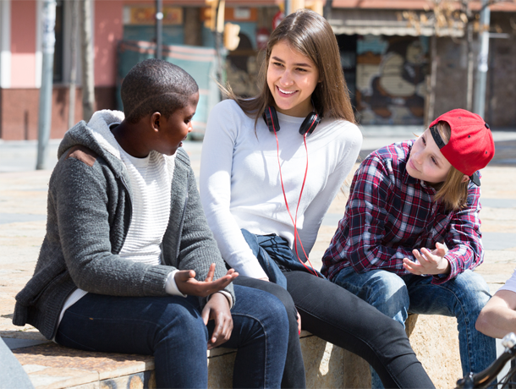

Nowadays when you lose something on the campus...
You check on Facebook if someone has found it
You ask your friends about it
You pray to see it again someday

Slide 3

Our
Idea
Help students, who have lost something, as efficiently as possible

Slide 4
An application that...
Makes looking for lost objects easier
Changes the way one returns lost objects

Slide 5
3 Concepts
Each member’s take on how the app should look like

Slide 6
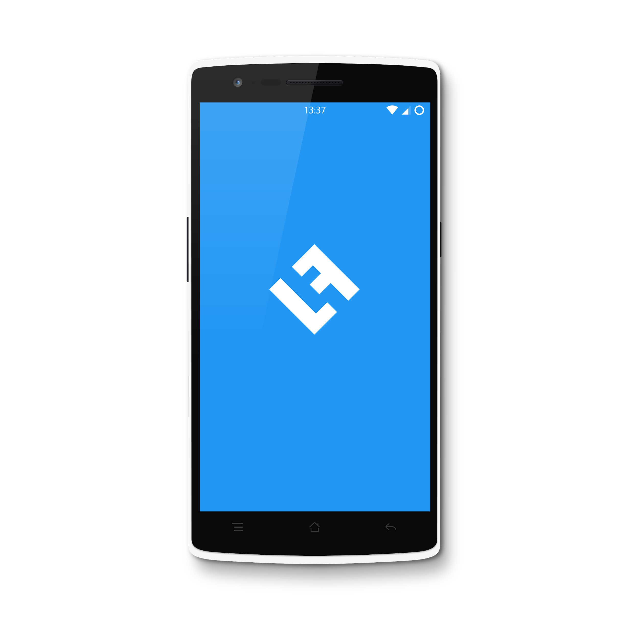
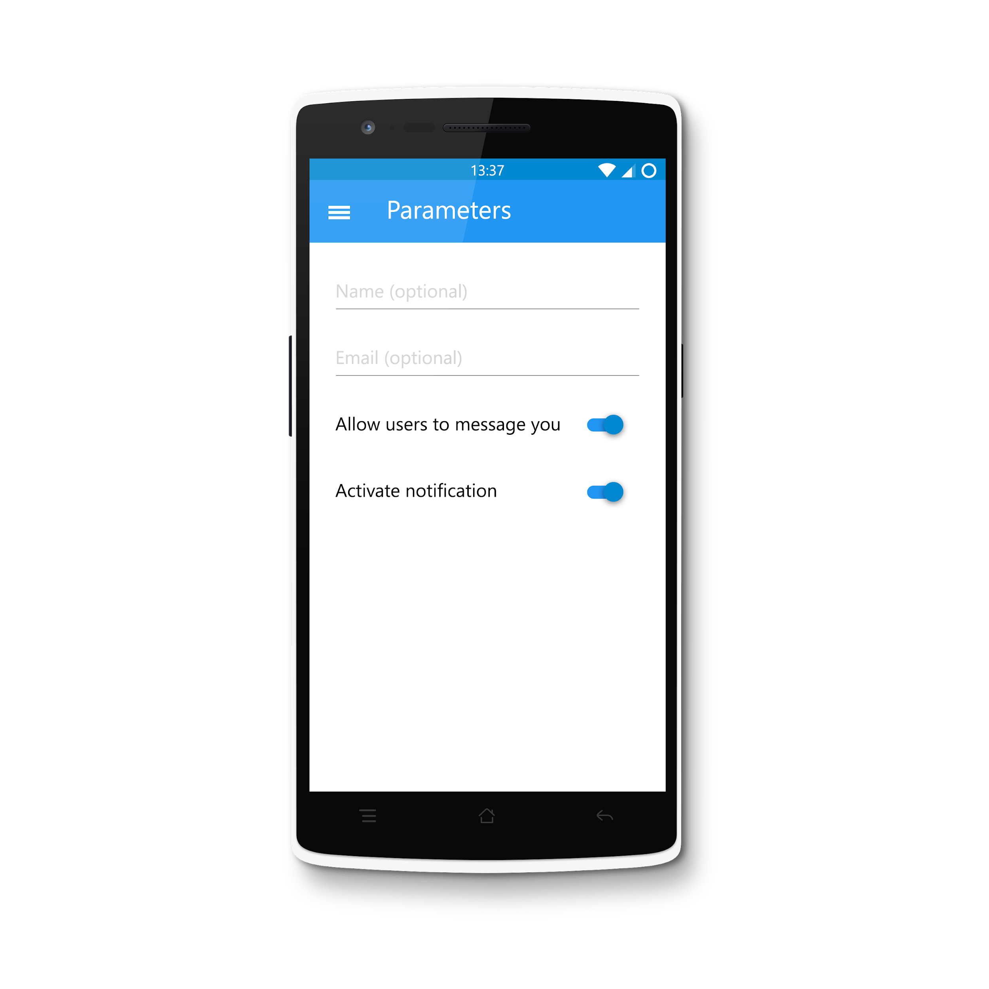
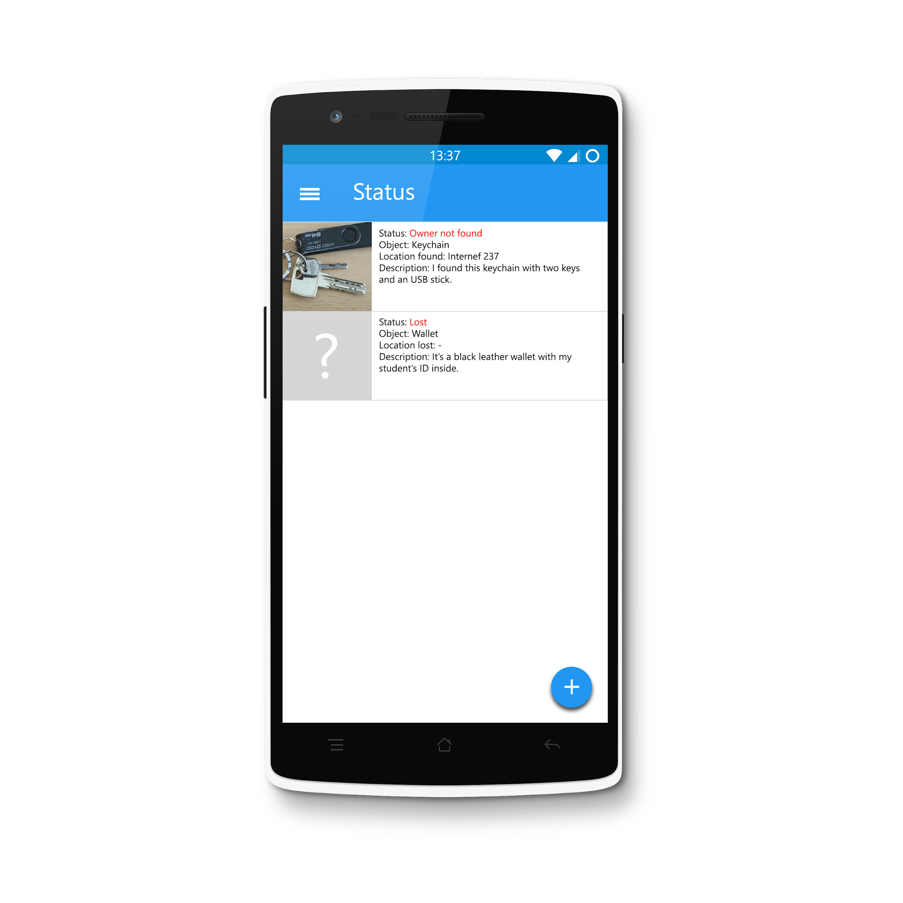
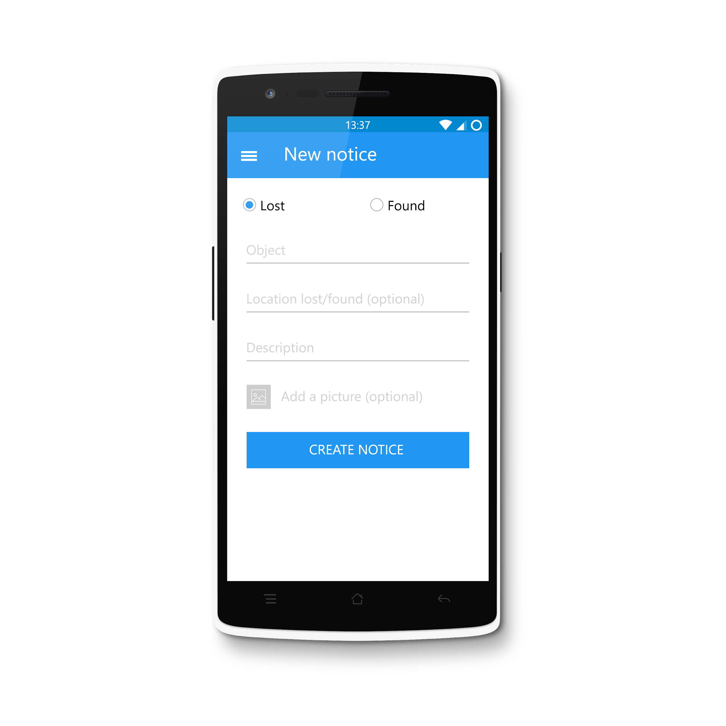
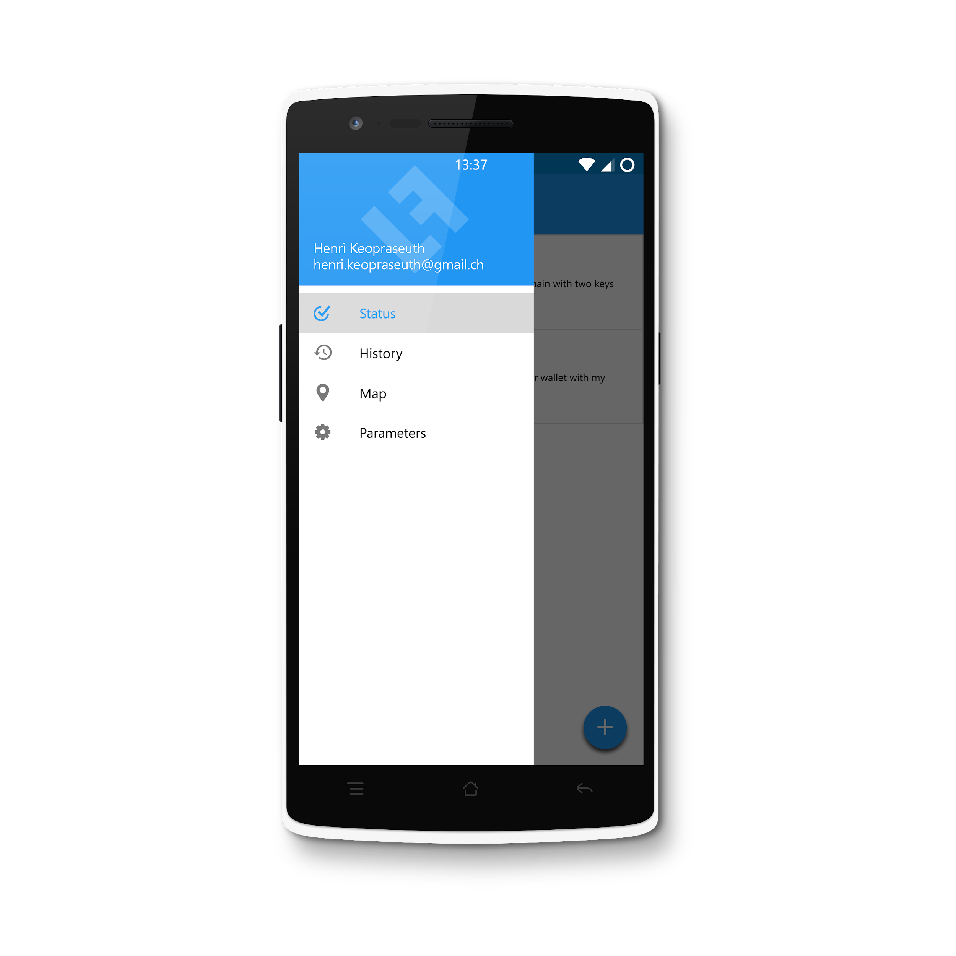
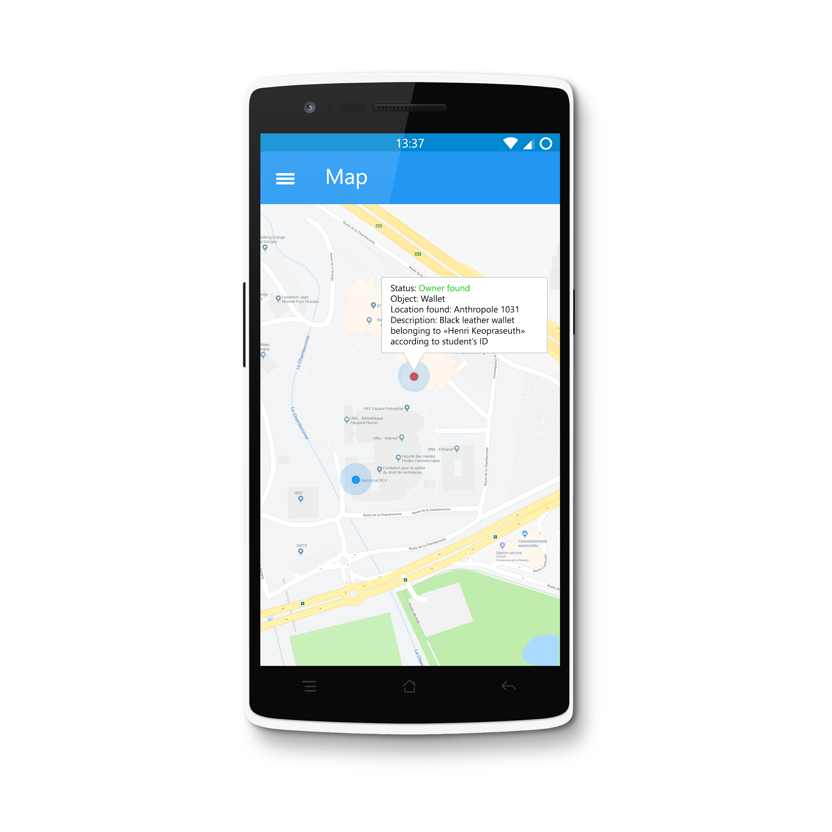
Concept 1
by Henri Keopraseuth

Slide 7
Concept 2
https://pr.to/RKLKKB/
by Aloïs Borgognon

Slide 8
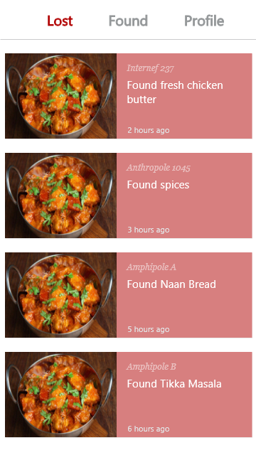
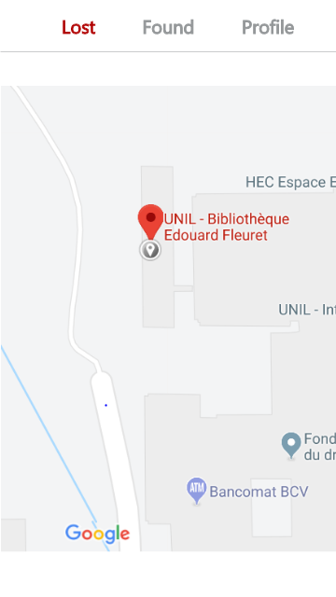
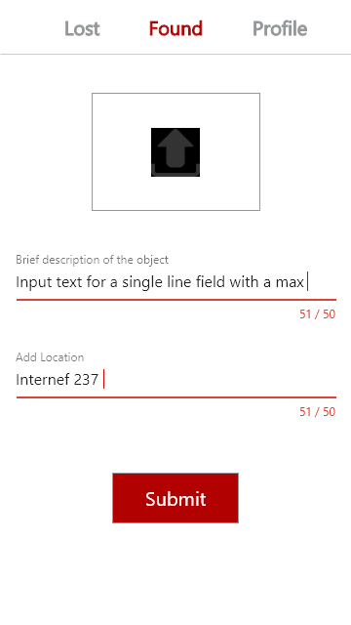
Concept 3
by Samuel Nguyen

Slide 9
Architecture, description and communication between building blocks

Slide 10
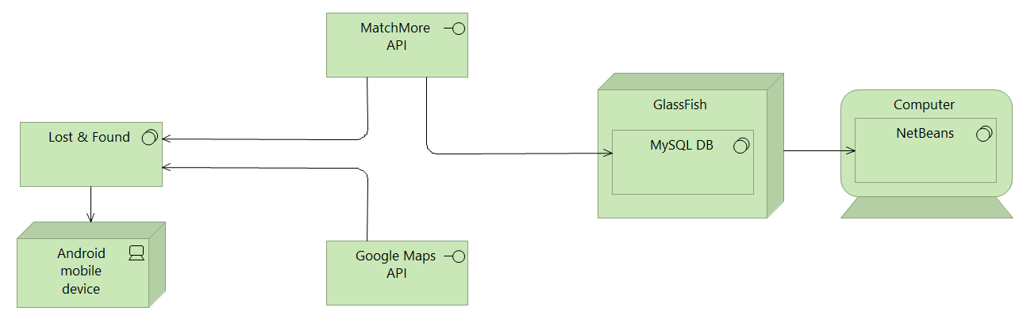

Architecture, description and communication
Client
API
Server
Made with ArchiMate Modelling Tool

Slide 11
Architecture, description and communication
When creating a new notice, the app will use MatchMore’s API to create a new publication/subscription (depending on the type of the notice) that will be stored in a database hosted by GlassFish
If there is a match, MatchMore’s API will indicate it to the app
We will then use Google Map’s API to show a map with our location within our app and use MatchMore’s API to indicate in the map where the object is
When both users (the owner of the item and the user that found it) are close, MatchMore’s API will trigger a notification for both devices

Slide 12
List of functionalities
Publish a new lost/found item
Check the status of your notices
Track the item (if matched) in real time
Message the person who found your item in-app (not sure yet)

Slide 13
Work distribution
Each member will try to work a bit everywhere, nothing is fixed as we don’t know each other coding capacities

Slide 14
Thanks!
Any questions?

